Slide 1






DATA ScIENcE PROJEcT
STROKE PREDICTION

Slide 2


DATA ScIENcE
Data science is an interdisciplinary field that uses scientific methods, processes, algorithms and systems to extract or extrapolate knowledge and insights from noisy, structured and unstructured data, and apply knowledge from data across a broad range of application domains

Slide 3







DATA
scIENcE
DATA MINING
DATA
cLEANING
DATA
VIsUALIZATION

Slide 4




PYTHON LIBRARIES
scikit learn: it is a machine learning library containing machine learning algorithms.
matplotlib: it is a python library used to represent numeric data in the visual formats.
pandas: this library is useful for cleaning the data or like organizing the data
numpy: it is the number processing library in python
scipy: it is the scientific number processing library in python

Slide 5

STROkE
PREDIcTION
heart stroke

Slide 6
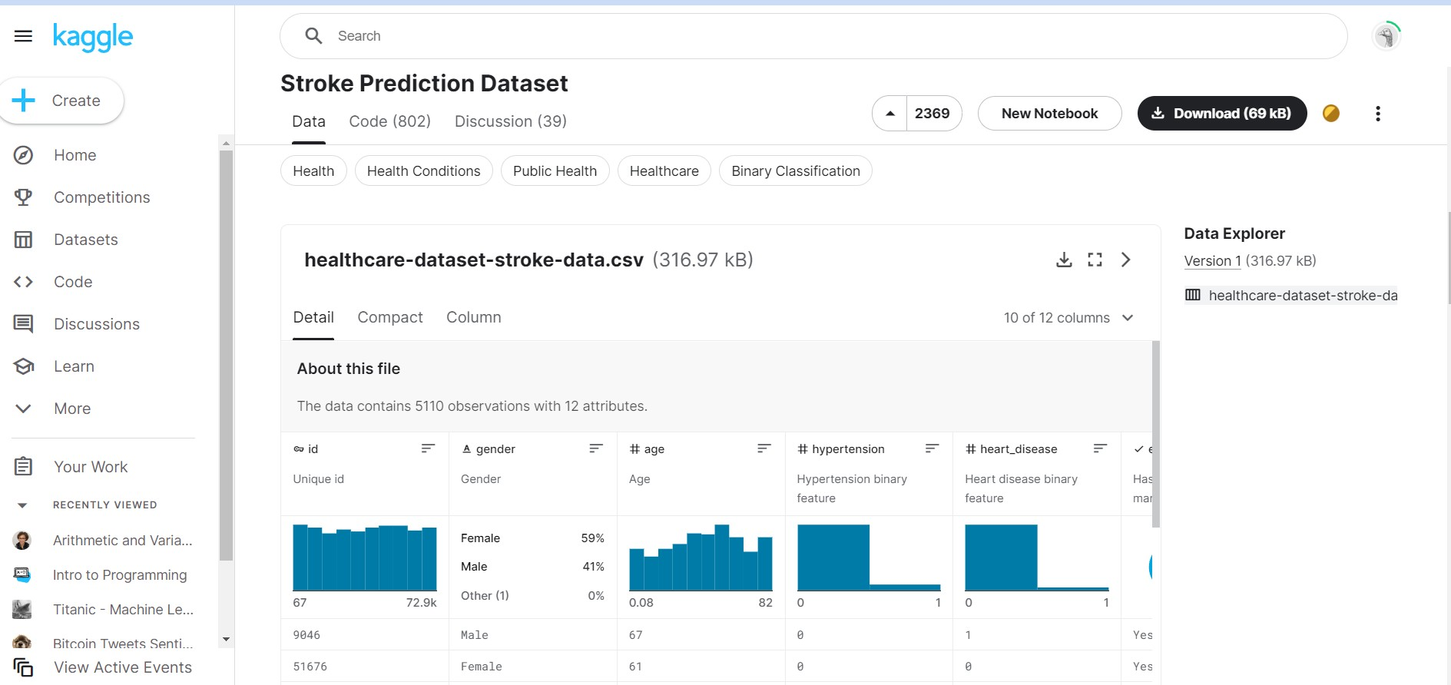
DATA IMPORTED FROM kAGGLE

Slide 7
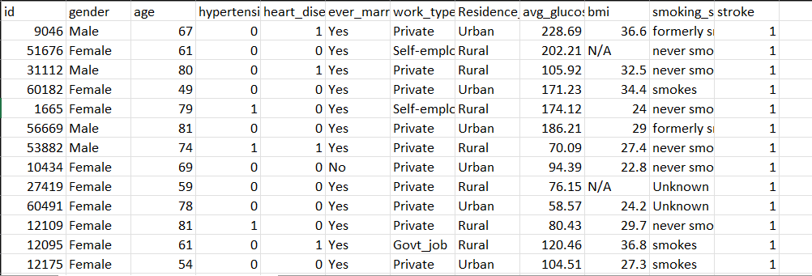
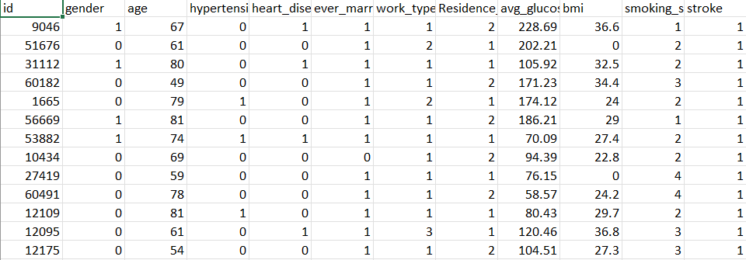
cONVERT STRING TO NUMERIc DATA
string data
numeric data

Slide 8

WE cLEAN THE DATA
removing unwanted data

Slide 9


DATA CLEANING
Data cleansing or data cleaning is the process of detecting and correcting corrupt or inaccurate records from a record set, table, or database and refers to identifying incomplete, incorrect, inaccurate or irrelevant parts of the data and then replacing, modifying, or deleting the dirty or coarse data..

Slide 10
TYPES OF DATA cLEANING
OUTLIER
outliers are those data points that are really far from the actual data points.
DUPLICATION
duplication just means that you have repeated data in your dataset. this could be due to things like data entry, errors or data collection methods.
NULL VALUES
null values are missing or missing data in the data frame. within data frame, a missing value is denoted by Nan.

Slide 11
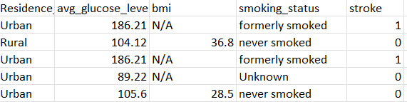
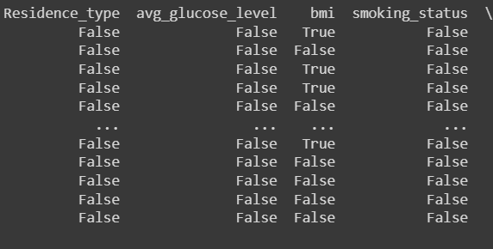
isnull()

Slide 12
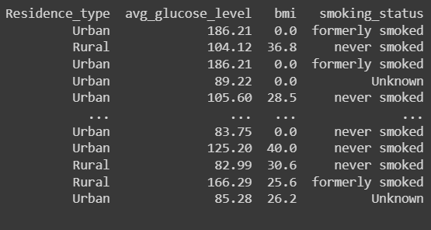
fillna()

Slide 13
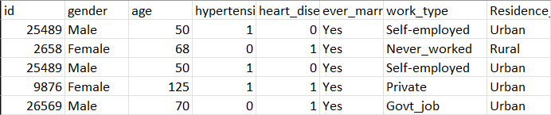
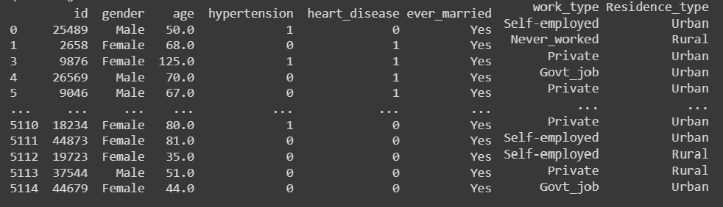
duplicates()

Slide 14
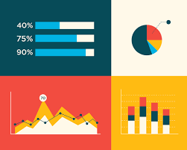
WE vISuALISE THE DATA
representing data in visual formats

Slide 15
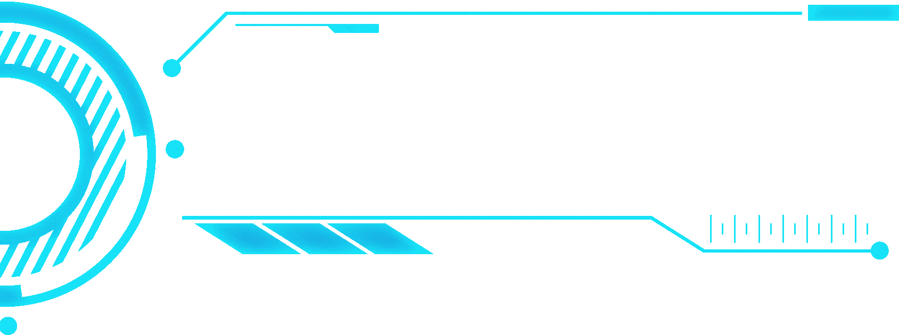




DATA VISUALIZATION
Data and information visualization is an interdisciplinary field that deals with the graphic representation of data and information.

Slide 16
WHAT IS THE PURPOSE OF USING VISUALIZATION?
Visualization lets you comprehend vast amounts of data at a glance and in a better way. It helps to understand the data better to measure its impact on the business and communicates the insight visually to internal and external audiences

Slide 17

CHARTS FOR SHOWING cHANGE OVER TIME
Histogram: in pandas is a representation of the distribution of data
Scatter Plot: is a type of data visualization technique that shows the relationship between two numerical variables
A bar plot is a plot that presents categorical data with rectangular bars with lengths proportional to the values that they represent.
A pie plot is a proportional representation of the numerical data in a column.
Line Chart The plot. line() function is used to plot series or DataFrame as lines. This function is useful to plot lines using DataFrame's values as coordinates.

Slide 18
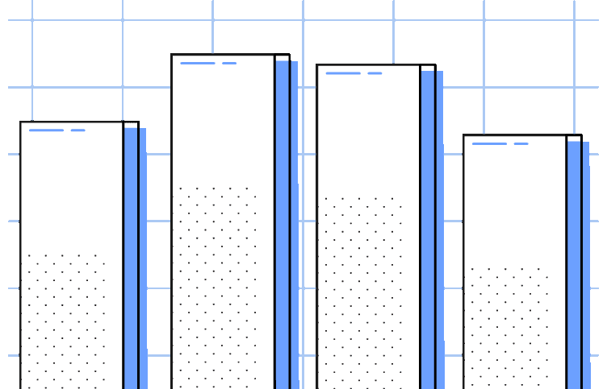
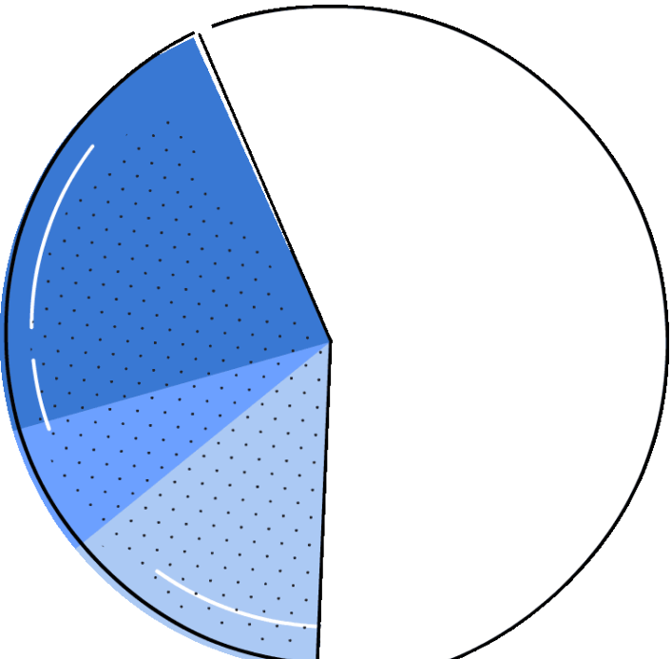
Folium : This allows you to manipulate your data in Geopandas and visualize it on a Leaflet map via Folium.
A Choropleth Map is a map composed of colored polygons. It is used to represent spatial variations of a quantity
A heatmap is a matrix kind of 2-dimensional figure which gives a visualisation of numerical data in the form of cells
A Waffle Chart is a gripping visualization technique that is normally created to display progress towards goals.

Slide 19
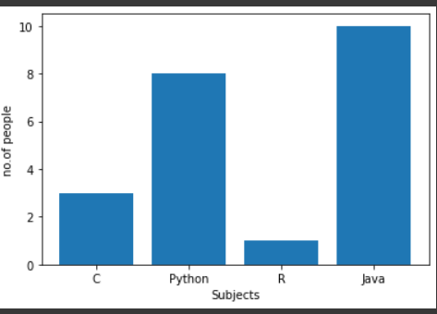
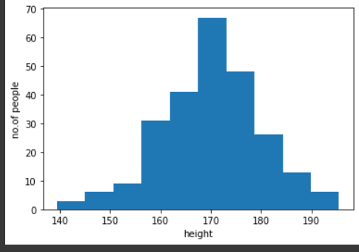
BAR cHART
HISTOGRAM

Slide 20
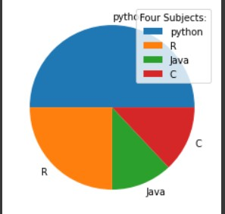
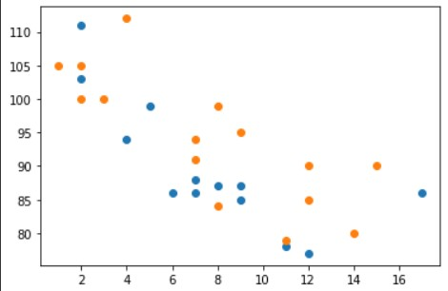
PIE cHART
ScATTER PLOT

Slide 21
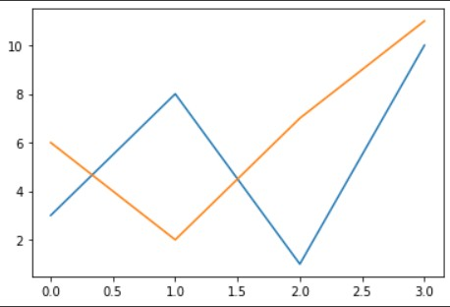
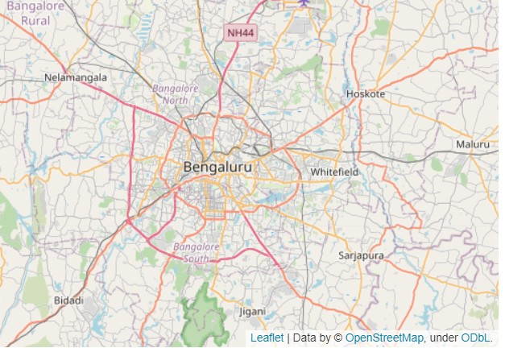
LINE cHART
FOLIUM

Slide 22
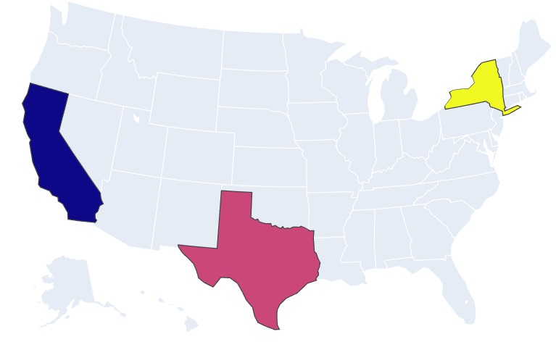
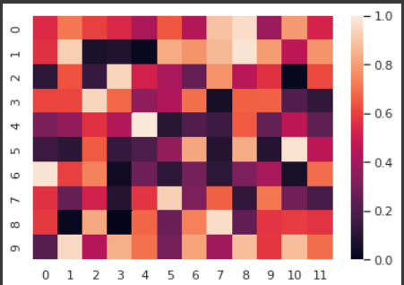
cHLOROpLETH
HEATMAp

Slide 23
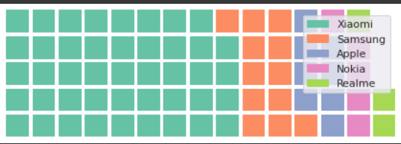
WAFFLE cHART

Slide 24

pREDIcTIVE ANALYSIS
Build model using ml algorithm to predict outputs

Slide 25


DATA MINING
The process of extracting information to identify patterns, trends, and useful data that would allow the business to take the data- driven decision from huge sets of data is called Data Mining.

Slide 26


MAcHINE LEARNING:
It is a type of AI that allows software applications to become more accurate at predicting outcomes without being explicitly programmed to do so.

Slide 27
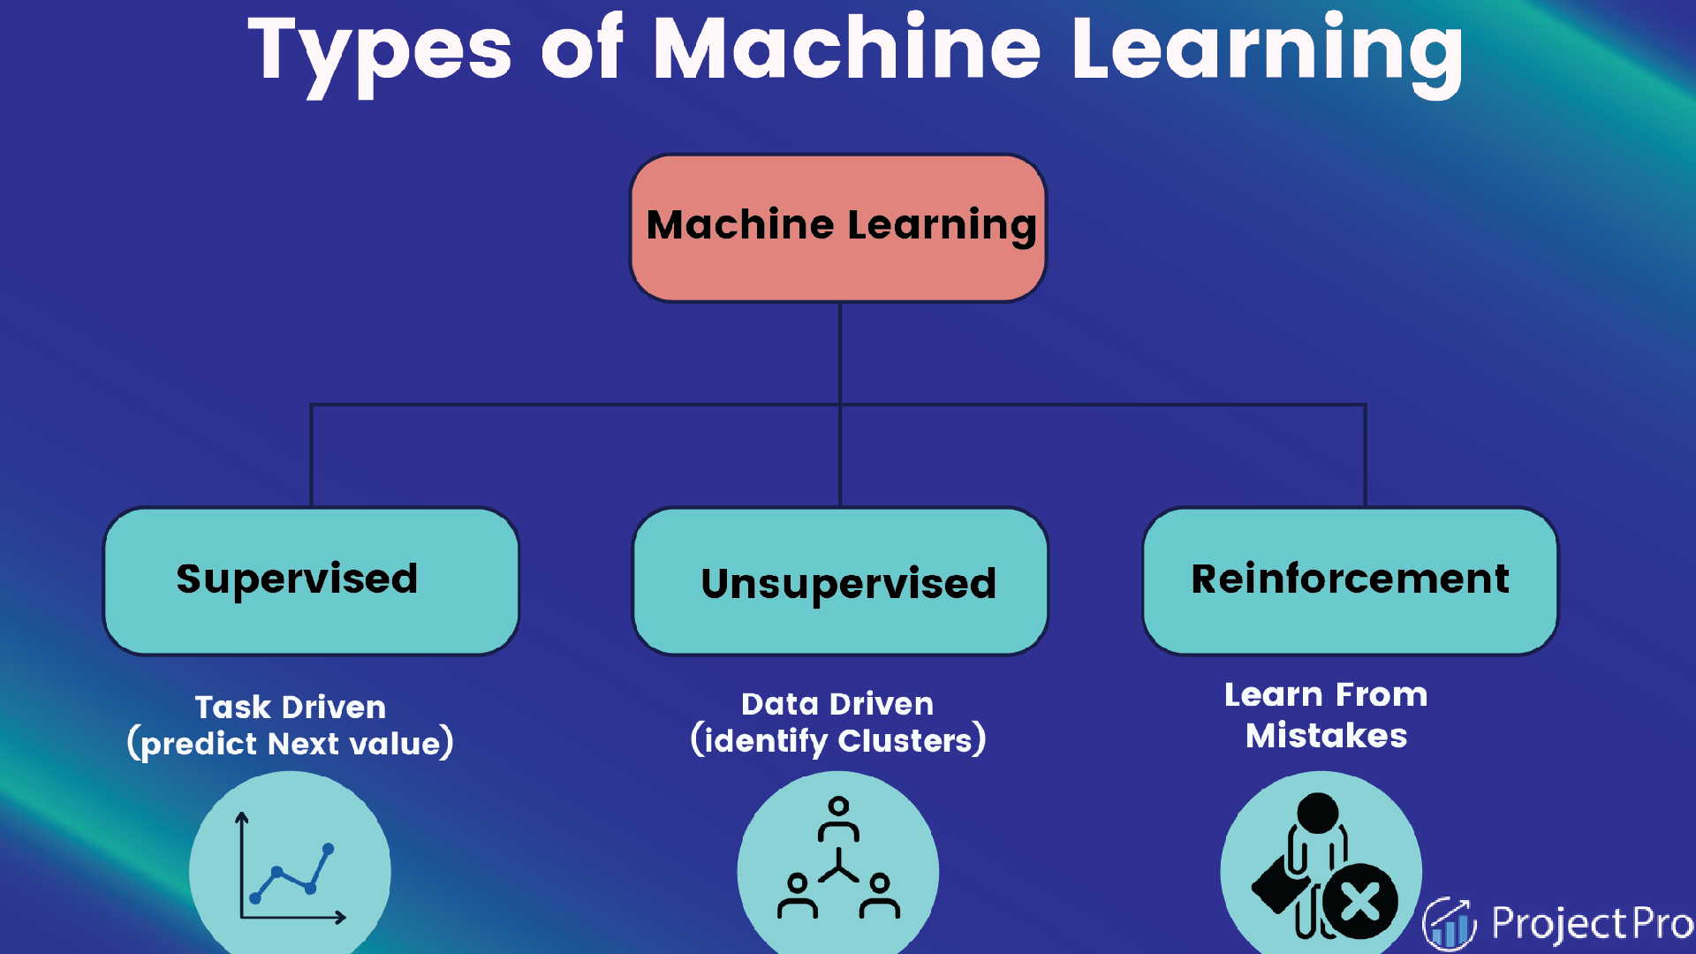

Slide 28

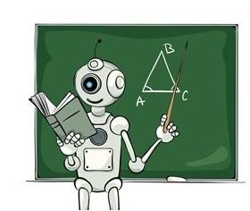
SUPERVISOR LEARNING :
Learning from others
Features and labels
Classification and Regression
Example : learning something new from a teacher and vise versa, here only two subjects are involved in the process thus acting as features and labels

Slide 29

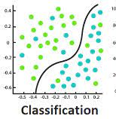
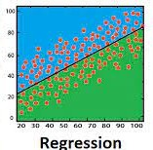
REGREssION AND cLAssIFIcATION :

Slide 30

REGRESSION :
Regression is a technique for investigating the relationship between independent variables or features and a dependent variable or outcome. It's used as a method for predictive modelling in machine learning, in which an algorithm is used to predict continuous outcomes.

Slide 31
cLASSIFIcATION:
Classification is the task of predicting a discrete class label.
in general, is a function that weighs the input features so that the output separates one class into positive values and the other into negative values, that is categorical segregation .

Slide 32

UNSUPERVISED LEARNING :
Learning on your own
Only features
Association
Example : learning something new by oneself, using just one’s resources

Slide 33
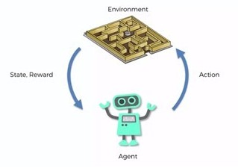
REINFORcEMENT LEARNING :
Self interpreting based on the system of rewards and penalty, learned through trial and error seeking maximum rewards.
Example : Dog is given a treat on doing the said action correctly , if the dog doesn’t do the said action the it won’t get any treat.

Slide 34

FEATURES , LABELS AND MODELS

Slide 35
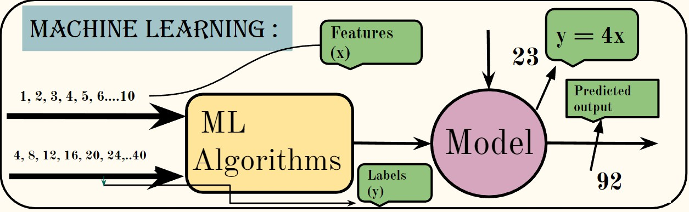
Features : input data
Labels : output data
Models : mathematical expression created from the given datasets using machine learning algorithm, thus helps in prediction for a new input.
Eg: flowchart of prediction model

Slide 36
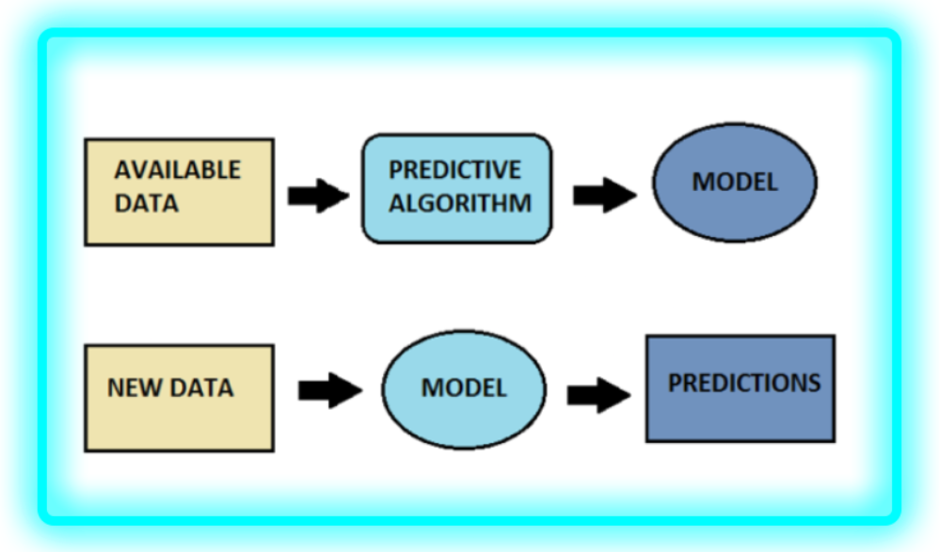

Slide 37

ML ALGORITHM

Slide 38
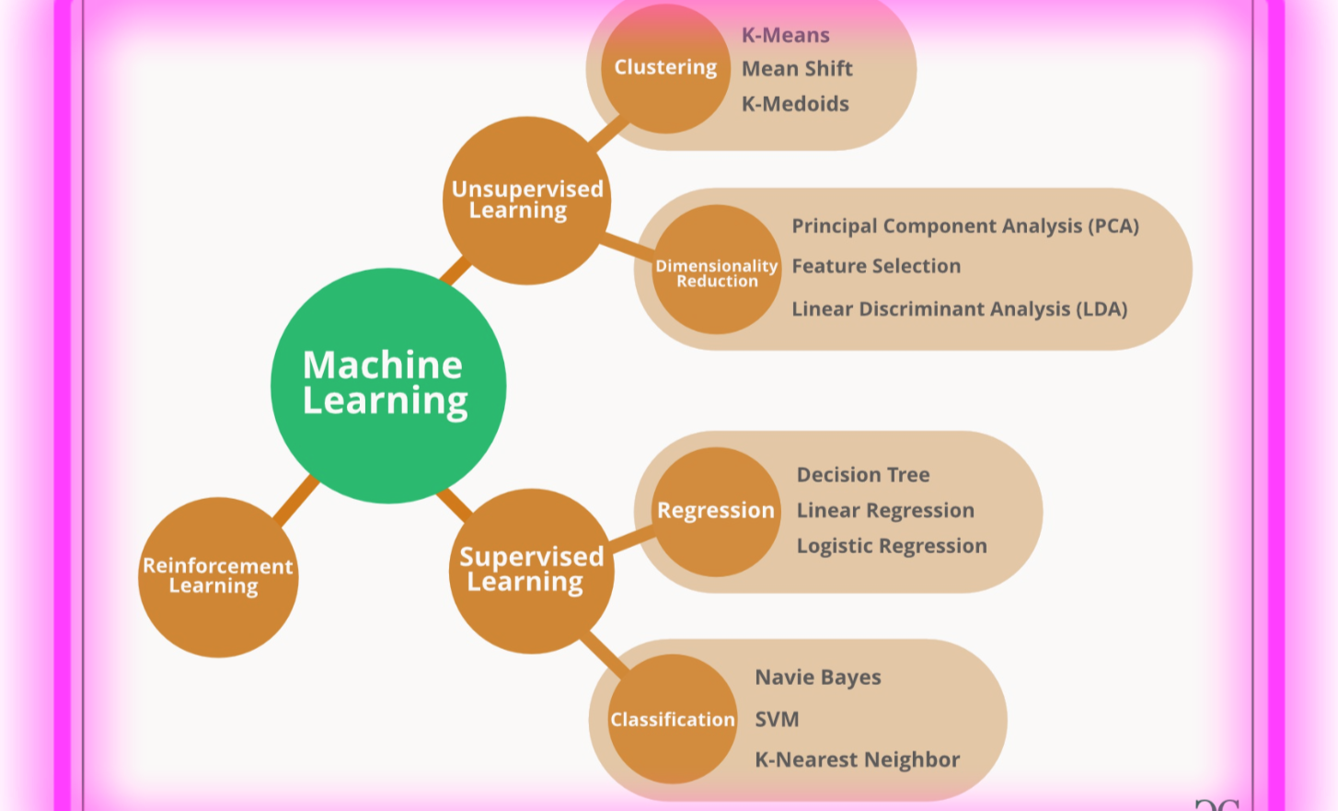

Slide 39
LINEAR REGRESSION:
In this process, a relationship is established between independent and dependent variables by fitting them to a line . This line is known as the regression line and represented by a linear equation y = mx+c
LOGISTIc REGRESSION:
This method is used to estimate discrete values from a set of independent variables. It helps predict the probability of an event by fitting data to a logic function.
DEcISION TREE:
This is a supervised learning algorithm that is used for classification problems. In this algorithm we split the population into two /more homogenous sets based on the most significant attributes/ independent variables.

Slide 40
SVM:
In this algorithm, we plot raw data as points in an n-dimensional space. The value of each feature is tied to a particular coordinate, making it easy to classify the data.
NAIvE BAYES :
A Naive Bayes classifier assumes that the presence of a particular feature in a class is unrelated to the presence of any other feature.
KNN :
This can be applied to both classification and regression problems. It stores all the cases and classifies any new cases by taking a majority vote of its k neighbors. The case is then assigned to the class with which it has the most in common.

Slide 41
K-MEANS :
In the unsupervised learning algorithm, data sets are classified into a particular no. of cluster are homogeneous from the data in other clusters
RANDOM FOREST:
A collective of decision trees is random forest. To classify new object based on its attributes, each tree is classified and the tree votes for that class. The forest chooses the classification having the most votes.

Slide 42
METHODS IN ML ALGORITHM
fit( ): This is responsible for estimating the attributes out of the input data and store the model attributes and finally return the fitted estimator.
predict( ): This will perform a prediction for each test instance and it usually accepts only a single input (X). The predicted values of the provided test instances will be returned in a form of an output of an array or sparse matrix.
score( ): This method is used to find the accuracy of the predicted data to that of the actual data.

Slide 43
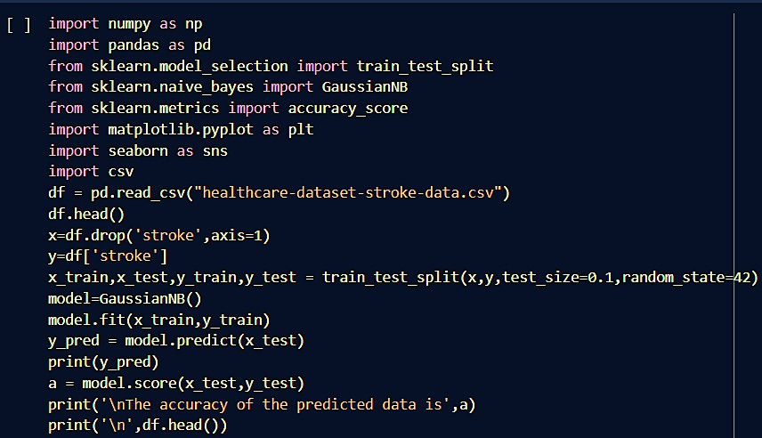
GIVE THE DATA TO A MAcHINE LEARNING ALGORITHM
Naive Bayes algorithm

Slide 44
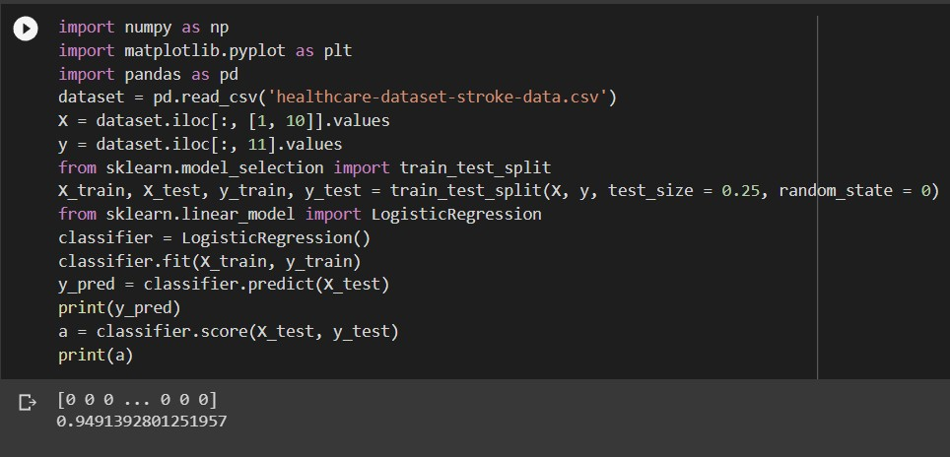
THE MOST AccuRATE ML ALGORITHM FOR OuR DATASET IS :
Support Vector Machine
94.9%

Slide 45

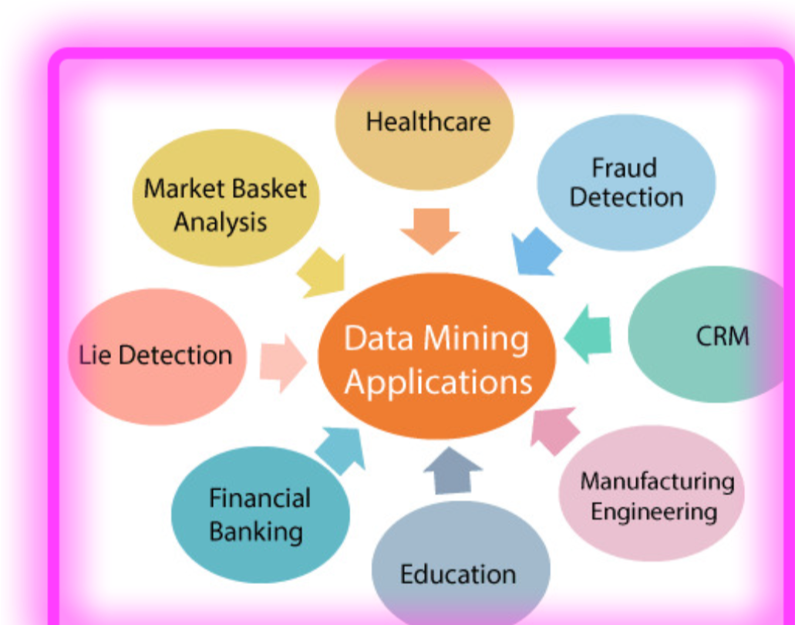
DATA MINING APPLIcATIONS

Slide 46




TEAM MATRIx
Donna R
Sri Vijayalakshmi AT Prasanna
Adishree K Maleka

